Slide 1
Annual Treasurer’s Report
June 12, 2022

Slide 2
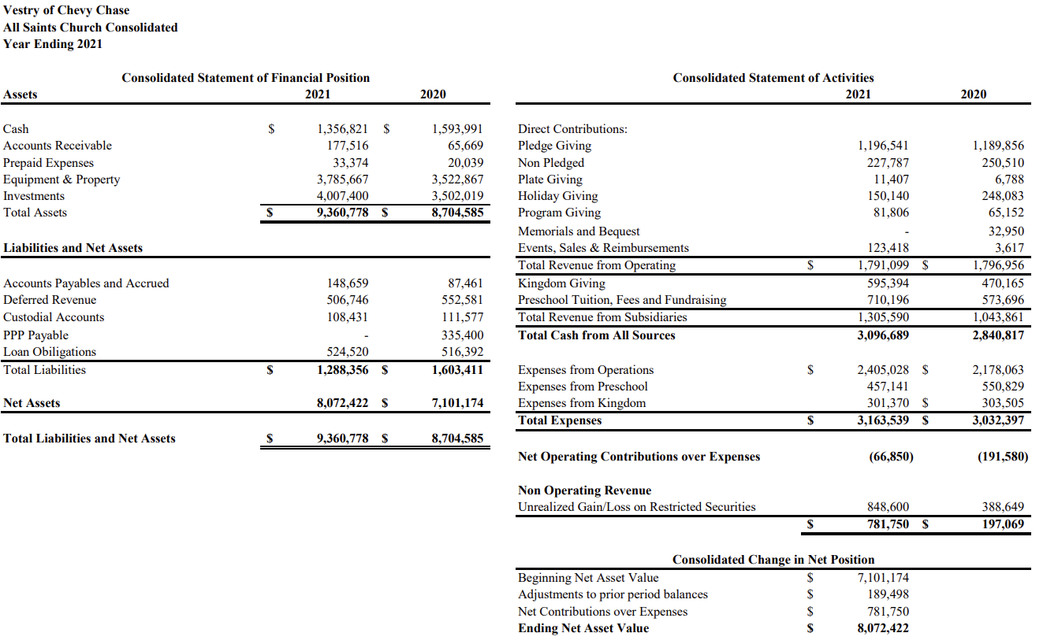
Financial Data FY 2021

Slide 3
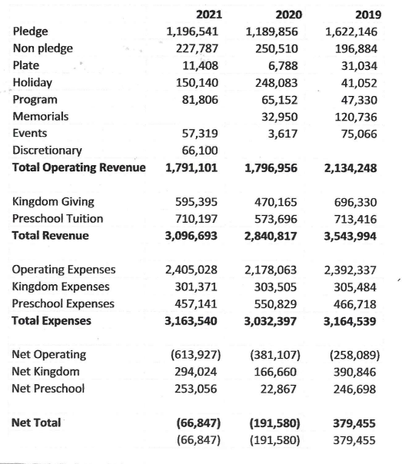

Financial Comparison FY 2019 to FY 2021

Slide 4
Financial Considerations for FY 2022 and beyond
  The addition of professional outsourced Accounting support in FY 2022 should improve strategic financial reporting for the parish.
  The Kingdom Campaign has transformed the church, but Kingdom contributions are now concluded.
  Our parish endowment has grown, but financial markets can be volatile.
  The parish has significant assets, but must be mindful of its cash flow.
  The parish has been blessed to weather the pandemic as well as it has, but the Vestry has reduced expenses in the FY 2022 budget and continues to look for expense line item efficiencies.
  Annual giving is the most important source of income for the church. Absent a return in giving to pre-pandemic levels, some very difficult choices regarding parish operational expenses will have to be made in the coming years.

Slide 5
THANK YOU

